Slide 1

TEAM -Agri Block
Blockchain Technology
Team Member
Astha
Puja Kumari
Prince
Dharmendra

Slide 2
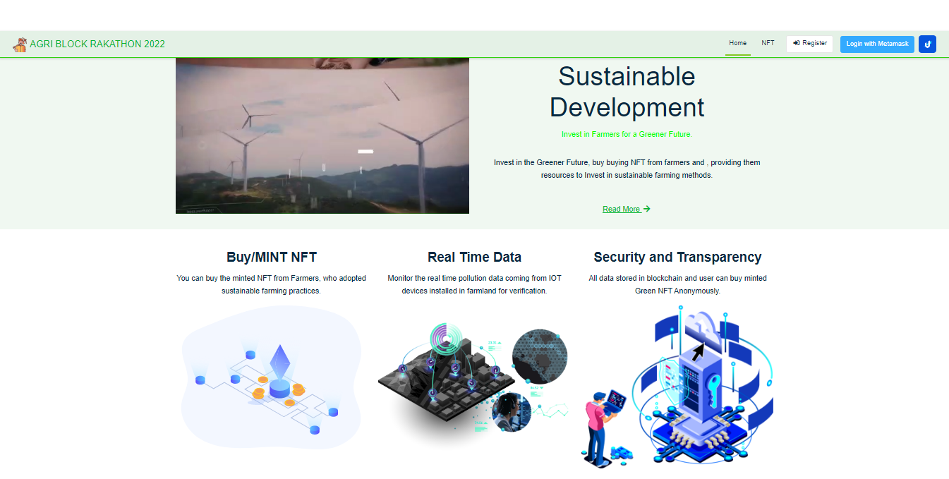

Slide 3
Problem Statement - Sustainability (Green Tech)
The United States Environmental Protection Agency (EPA) estimates that 10% of CO2 is emitted by the Agri sector. On one hand, Agri companies have sustainable products and services to offer to the growers. On the other hand, without proper economic incentives, farmers are reluctant to adopt sustainable practices.
Centralized platform business models have so far not succeeded in creating economic value for the farmers, even while the demand for a voluntary carbon market is increasing. What technologies and business models can enable financially incentivize farmers for implementing climate-smart practices? What are the ways the buyer has proof of authenticity? In what ways the participants including investors can derive economic value ?

Slide 4
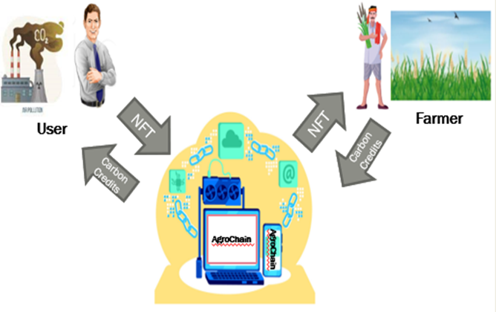





Slide 5
Solution
An Agricultural Supply Chain tracks a farm product from the farmer to the consumer. Agri Block is an NFT application Based on Ethereum Blockchain written in Solidity Smart Contract, and using the power of React Frontend, and ether.js to interact with the Smart Contract present in the Ethereum Blockchain, a user can register as a Framer inn the application, with all relevant information, Upload & Mint (In IPFs), buy and Sell NFT, in the Agri Block NFT marketplace. The Industries then, can buy those NFT from market place granting them carbon credits, and also investing money in farmers so that they can adopt more sustainable framing practices. and a win-win situation for all, the Air Quality verification is done using IOT devices, thus acting as a verification mechanism to ensure, that money is invested by farmers to adopt more sustainable farming methods.

Slide 6
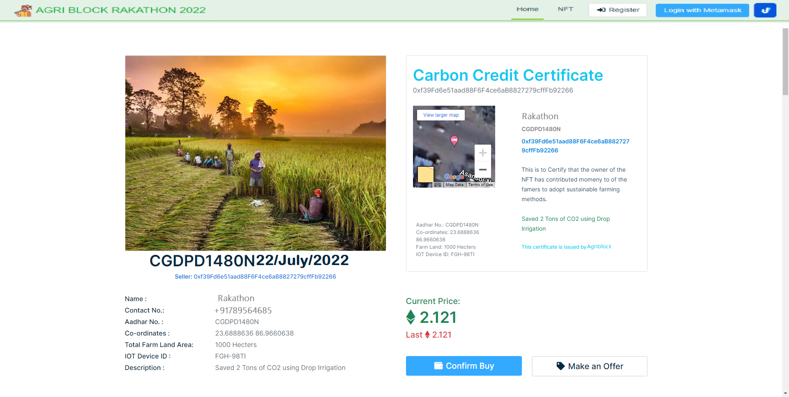


Slide 7
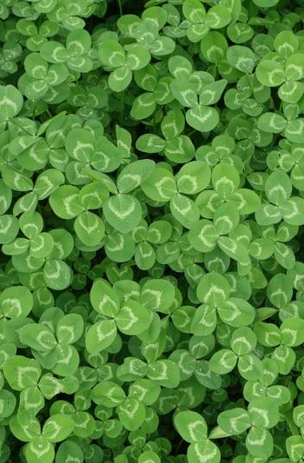
Features
1.Farmer Registration.
2.Mint NFT for Carbon Credits using Verification from IoT Data to prove sustainable farming practice is adopted.
3.IoT Device data is Directly streamed to NFT for verification using Device ID and Azure IoT Hub.

Slide 8
4.User Dashboard to view all the NFT Minted, sold, and Purchased.
5.Customer/ Industries can buy NFT carbon credits to meet their ESG Goals, and remain Carbon neutral companies.
6.Money in form of Cryptocurrency is directly transferred to farmers without commission and middlemen, so they can invest the money in adopting more sustainable farming methods.

Slide 9
Roadmap
Farmer Registration.
Carbon Credits using Verification from IoT Data
Device ID verification using Azure IoT Hub.
1
3
5
2
4
6
Create NFT Using Given Data
IoT Device data is Directly streamed to NFT
Money in form of Cryptocurrency is directly transferred to farmers without commission

Slide 10
Implementation
Agri Block is an NFT platform where farmers can register and sell carbon credits in the form of cryptocurrencies.
Agri Block will provide authenticity to the information collected by farmers using IOT device which will check the carbon emission caused due to agricultural process.
An organisation/company will be able to visit the details provided by farmers and buy carbon credits to compensate the carbon emission.

Slide 11
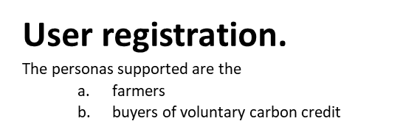
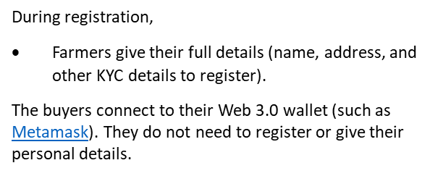
User Registration

Slide 12
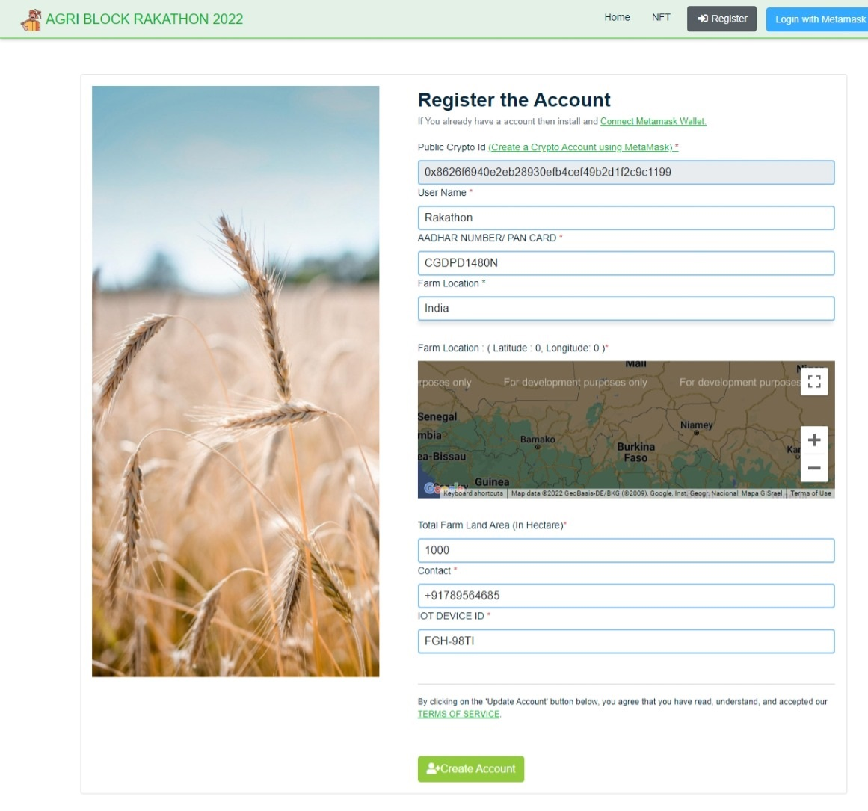

Slide 13
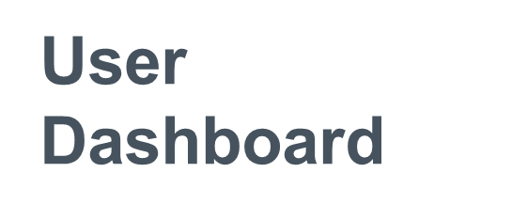
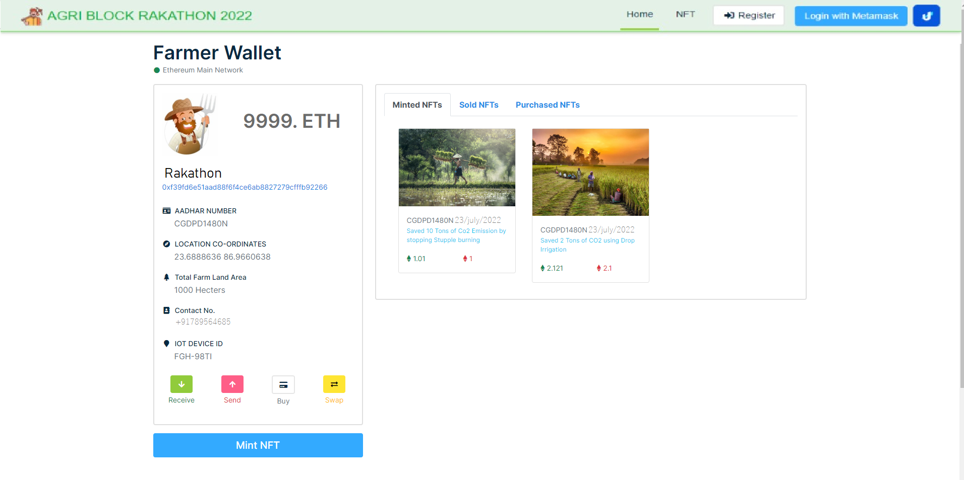

Slide 14
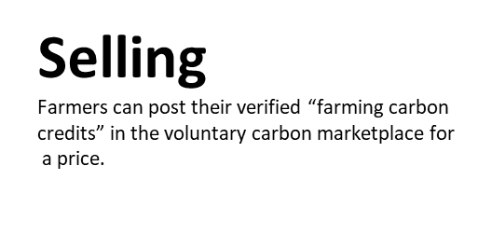
When the farmer posts their details, the system “mints” a unique NFT with details of farm image, the farmers property geocoded, amount of carbon emissions reduced displayed in it.
To ensure the farmer cannot submit the same data twice for sale? Who verifies if their reduction in carbon emissions? Including a human-in-the loop is always prone to corruption.
O This is where a IoT based solution will be augmented in real-life.
O For instance, take the stubble burning. There will be field sensors in the farm that will measure CO2 and other air quality periodically in the farm. The air quality data collected so collected in the farm will be pushed with a timestamp. This data becomes the foundation for computing the reduction in emissions.
Where will you store this data? This source of truth data also needs to be immutable. For this purpose, you could store this data in IPFS or other scalable ledgers.

Slide 15
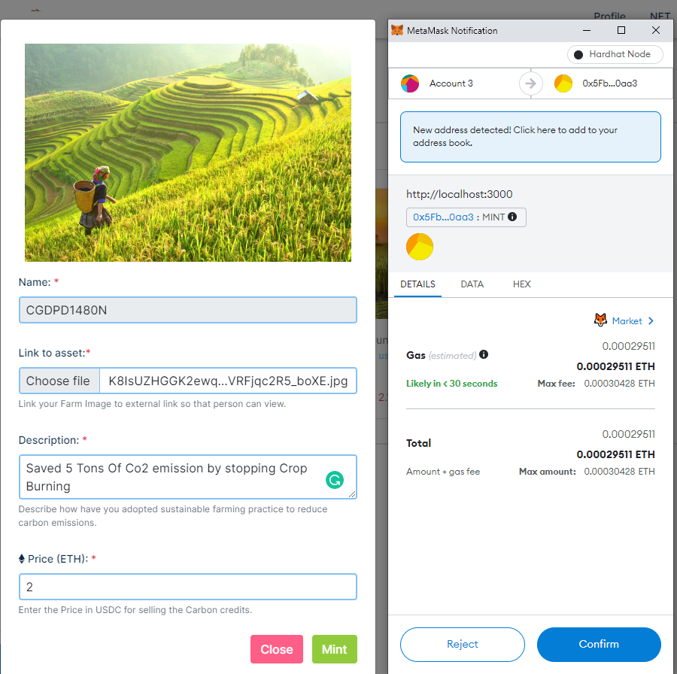

Slide 16
Buying
Buyer can view and buy “farming carbon credits” from the marketplace.
·Designed a simple marketplace that lets the buyer view and filter (price etc.) what the farmers have posted.
·To buy “farming carbon credits” they use a crypto currency native to the public blockchain i.e. Ethereum.
·Upon buying the farmer’s Carbon Certificate, the NFT (digital asset) is transferred to the buyer using logic in smart contract.
After a purchase, the “farming carbon credit” is automatically removed from the marketplace.

Slide 17
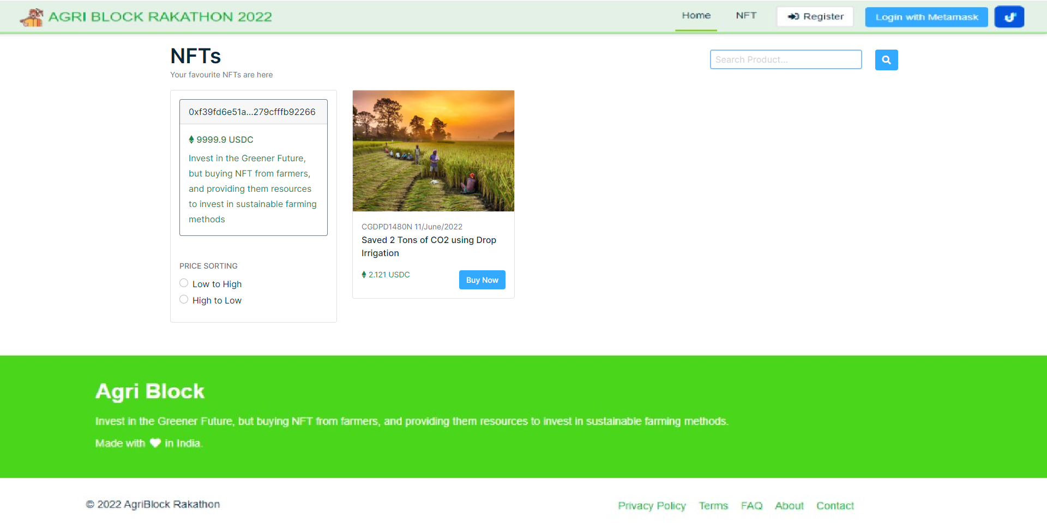

Slide 18





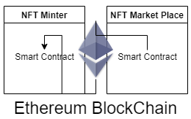
Using React Frontend Web
Web3 Application
Storing to image Data
Storing image metadata and URL to blockchain
IPFS peer to peer Network
Using ether.js to Communicate with the smart contracts,using meta-mask​
Use Hardat to deploy smart contracts to mainnet,or testnet

Slide 19
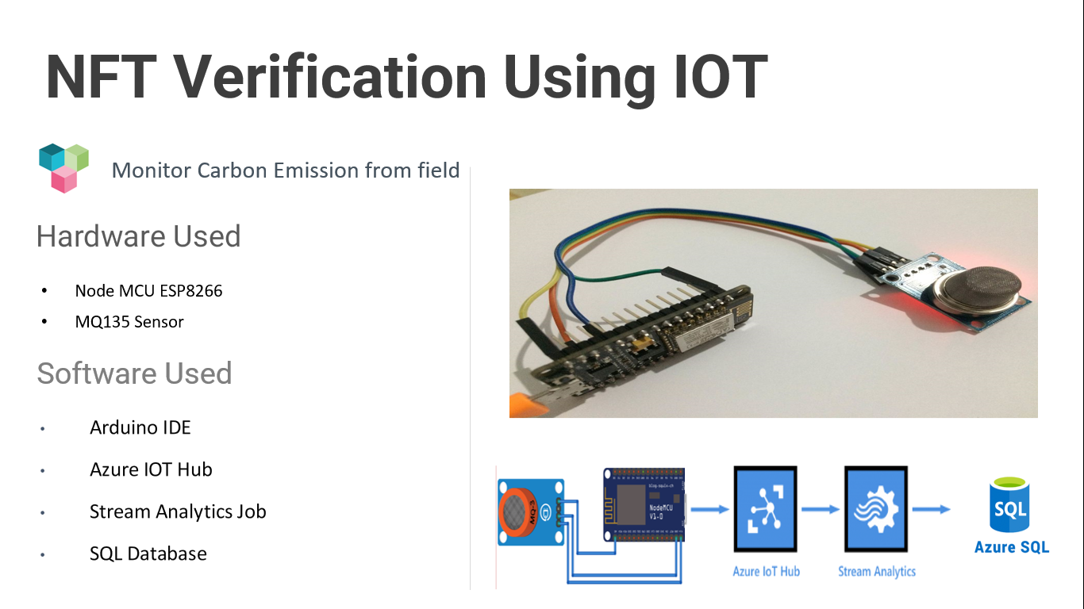


Slide 20
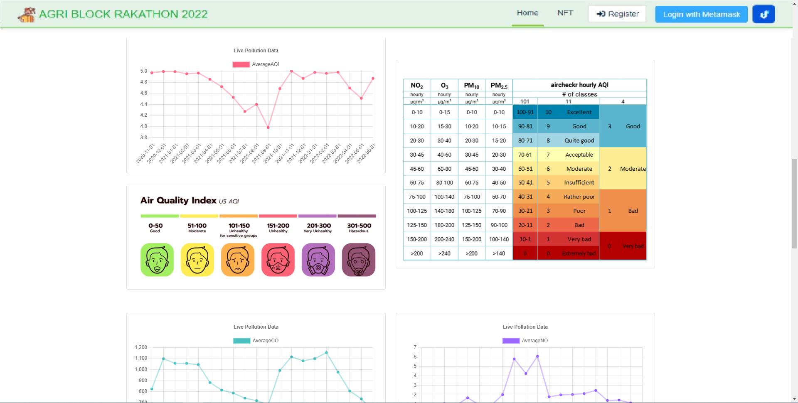

Slide 21
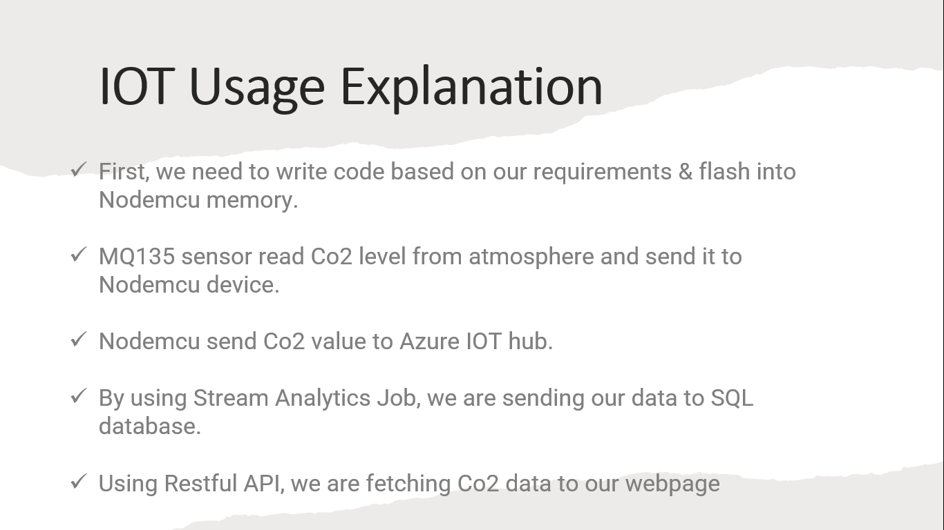

Slide 22
Tech Stack
React JS
IPFS
Solidity smart Contract
Ethereum
ESPB266 Arduino kit
Azure IOT hub
Meta Mask
Ether.js

Slide 23
Thank You

